Slide 1


Hands-on Biological Data Science with R
Introduction

Slide 2
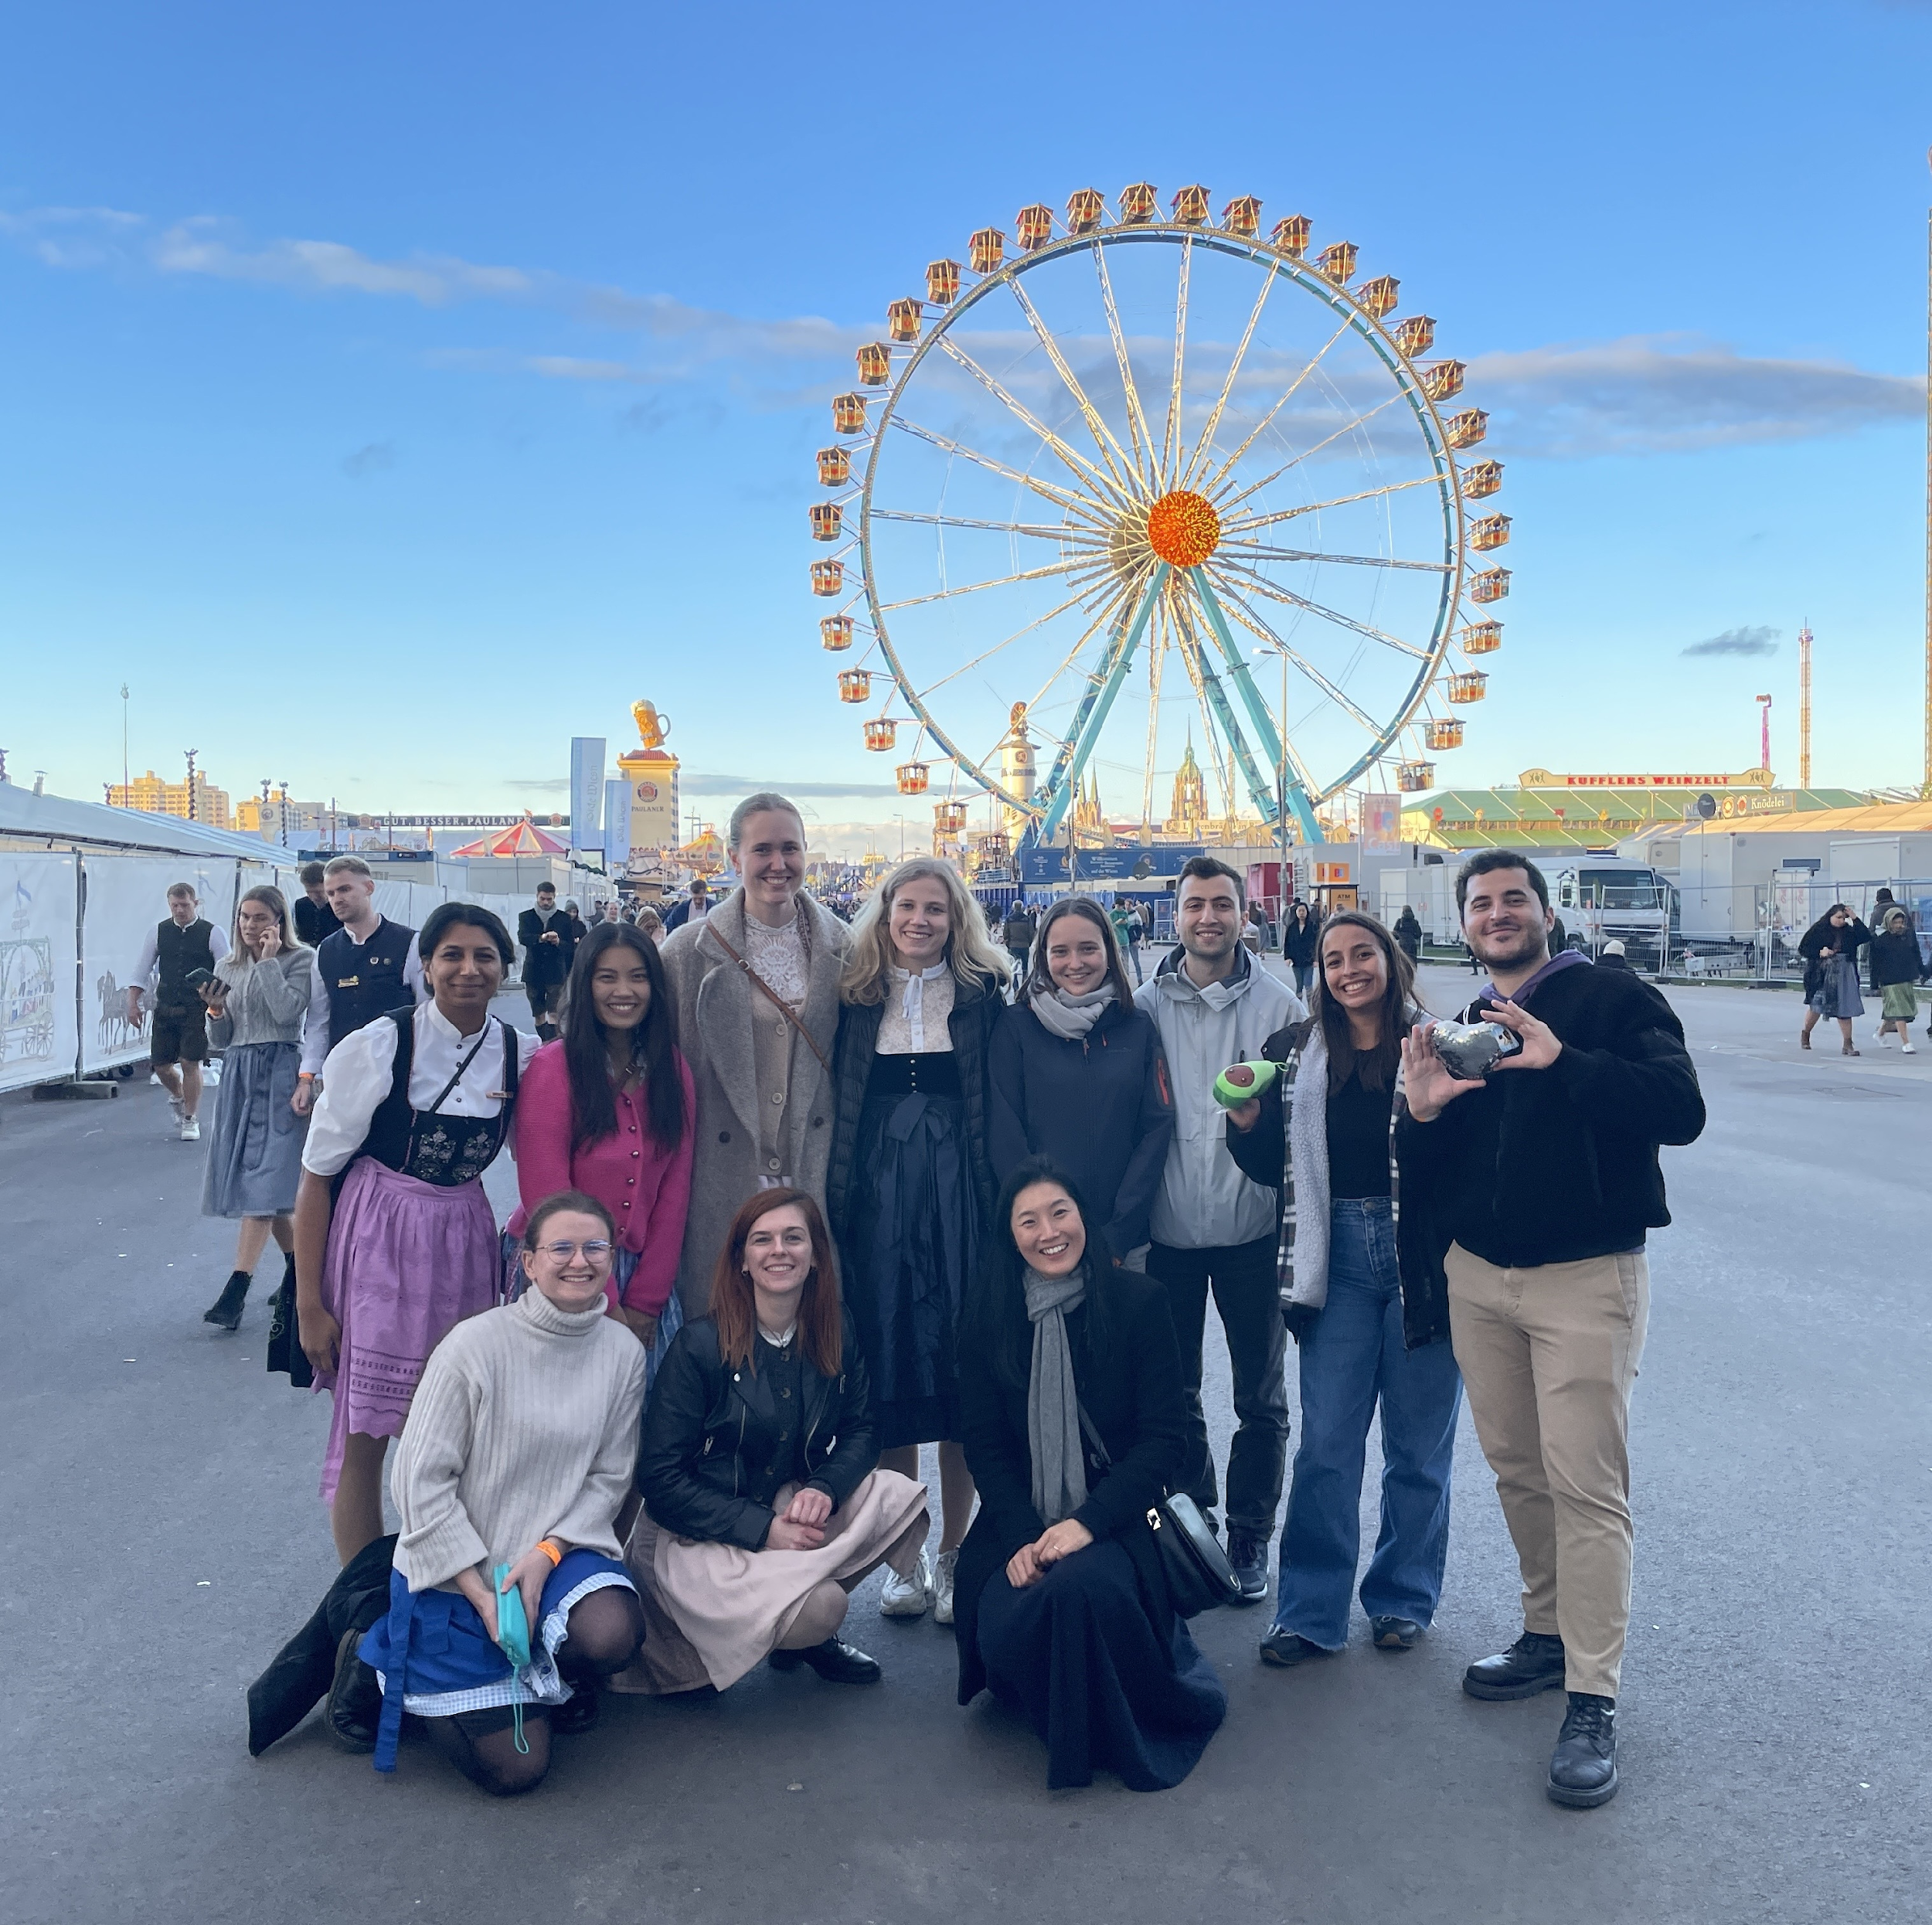
About Us
Kim - Hellmuth Lab
International and Interdisciplinary Team
We’re a diverse group of people with various backgrounds in all levels, combined with in our shared passion for this field.
Translational Immunogenomics Focus
We explore the genetic basis of human immune response variation, with the aim of utilizing those insights in the clinic.
Dual Affiliation with Helmholtz Munich & LMU
We are based both at Helmholtz Munich Computational Health Center and LMU Hospital.

Slide 3
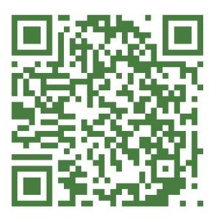
About Us
Kim - Hellmuth Lab
If you are interested - Reach Out !
We always welcome enthusiasts who wants to pursue opportunities in our lab, and thanks to our interdisciplinary work, we can offer a range of projects from wet lab to dry lab for all levels.
You can
“Forschungsmodul” LMU
Internships
HiWi positions
MD Thesis …

Slide 4
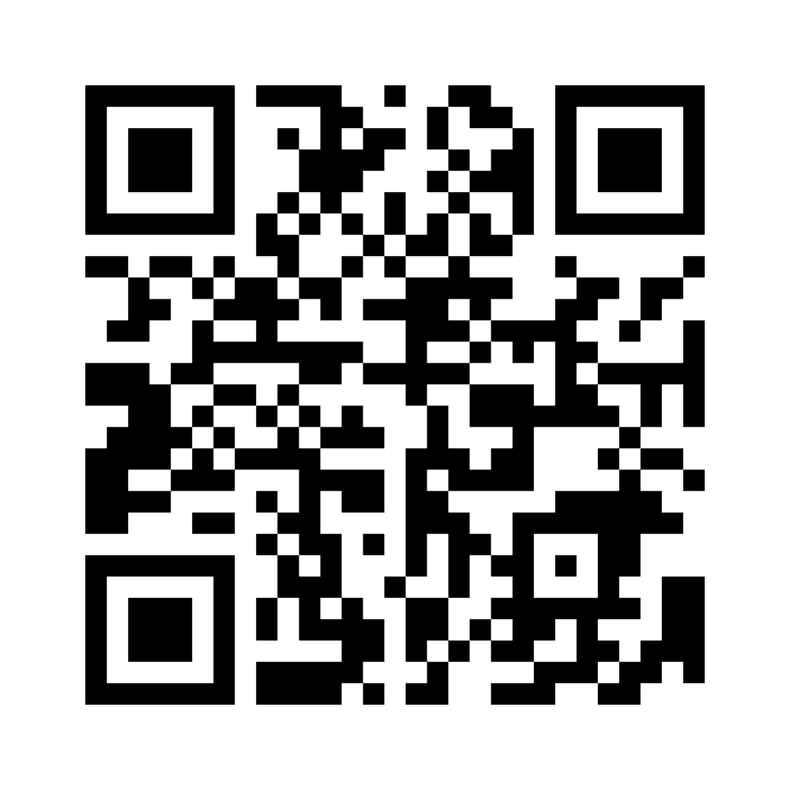
What comes to mind when you think of Biological Data Science?
https://www.menti.com/alk8qmgqdg9s

Slide 5
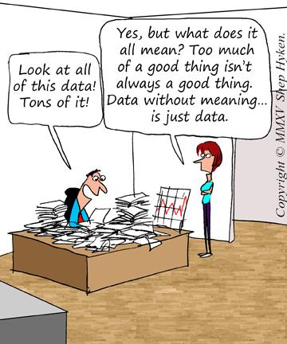

Slide 6
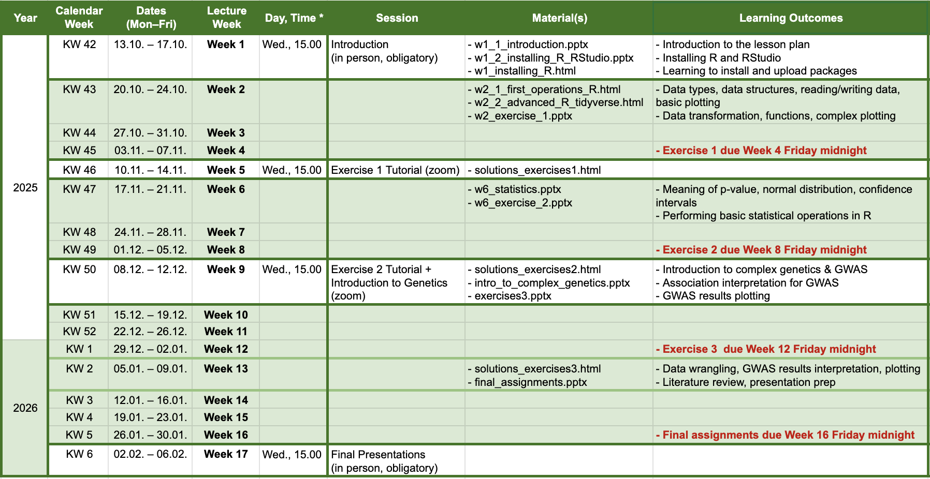
Lecture schedule
WiSe 2025/2026
Self study
Self study
Self study

Slide 7
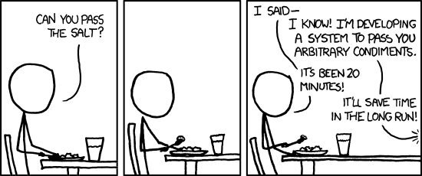
Exercises and final assessment
WiSe 2025/2026
All self-study materials and exercises will be uploaded in moodle.
Beware of deadlines for submitting your exercises.
When you feel like stuck, reach out to your classmates, use the Forum in Moodle or look for the answers in the Web/Stack Overflow (and ChatGPT, although be aware of it’s limitations)
Final assessment: Preparing a presentation of biological data science task.
Optional for bonus credit: Prepare a short summary (max. 2 slides as part of your final presentation) about a modern method in human genetics (e.g. single cell-seq, ATAC-seq, PheWAS, QTLs). (will count as a extra exercise)

Slide 8
Thanks for your attention!
Contacts:
Ekin Yaman Dr. med. Sarah Kim-Hellmuth
✉: Ekin.Yaman@med.uni-muenchen.de https://www.ccrc-hauner.de/kim-hellmuth-labor
Dr. med. Paula Rothämel
✉: Paula.Rothaemel@med.uni-muenchen.de

